Slide 1
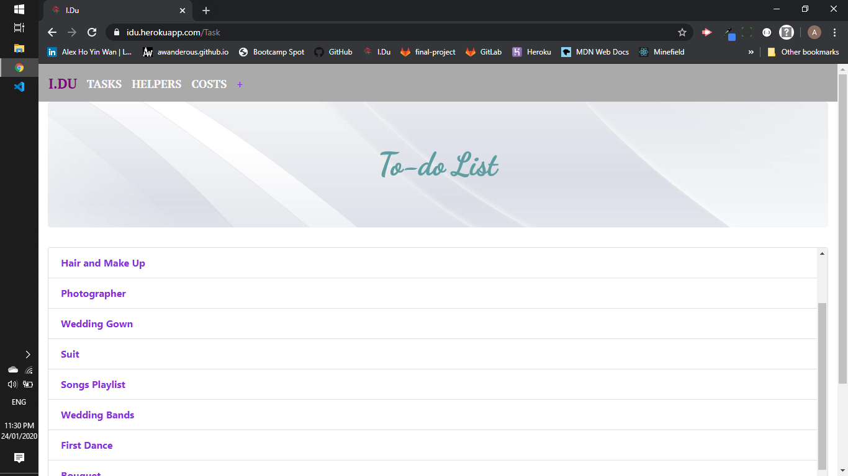
I.Du

Slide 2
What is I.Du?
Couples looking to get married
Easy way to organise

Slide 3
Future Opportunities
Cost added up to the end
Runsheets for the timetable of the day
Different authority login for both the couple and the helpers
Wedding Advertisments

